Slide 1
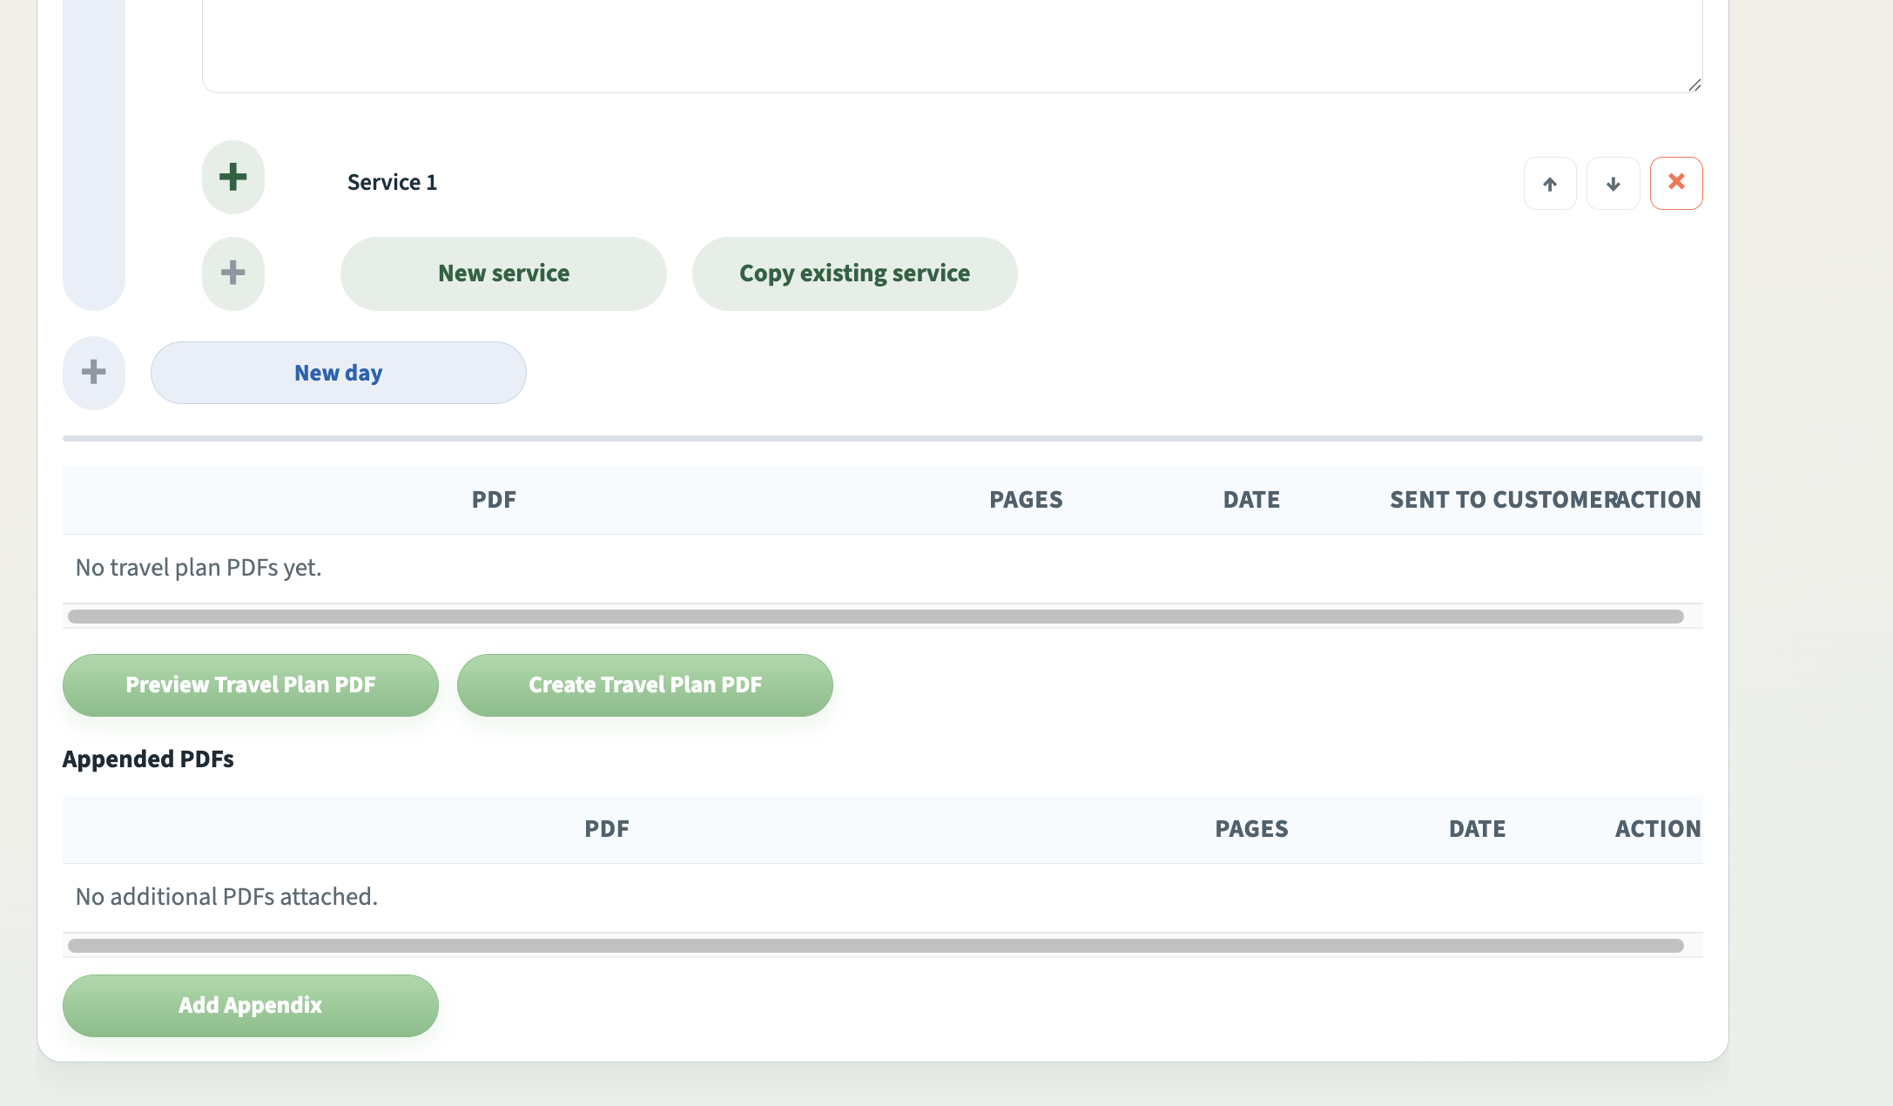

Preview PDF
Create PDF
Add Attachment

Slide 2
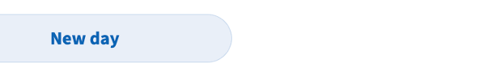

Slide 3



Slide 4


Slide 5
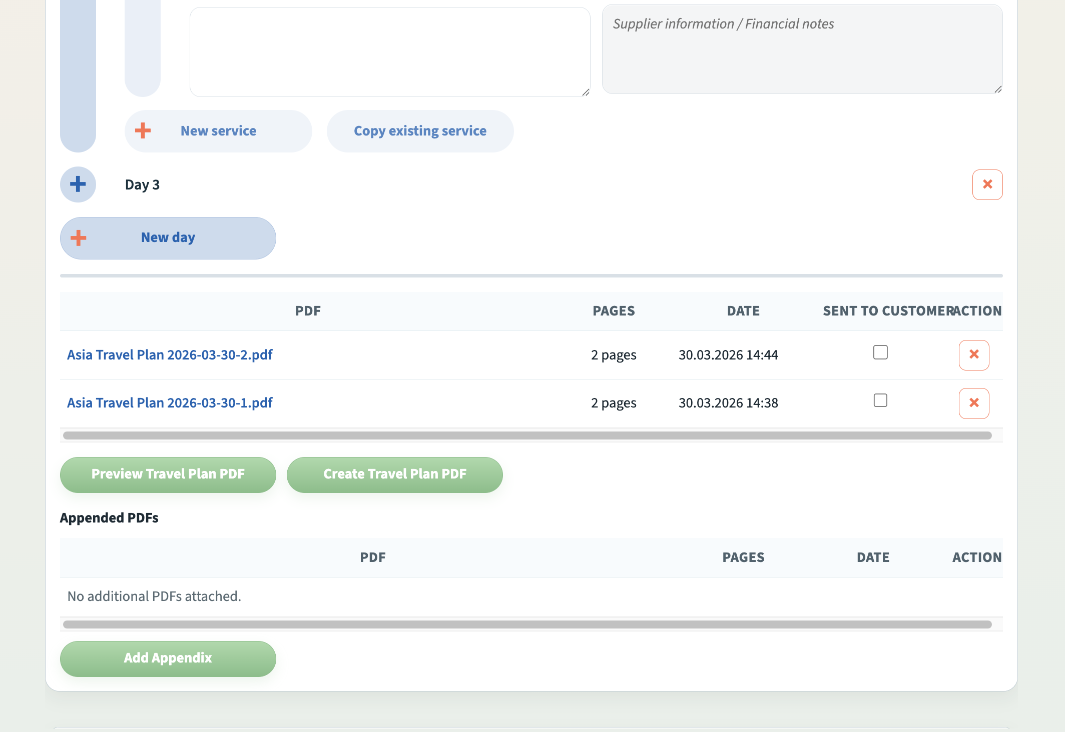


Slide 7


Slide 8
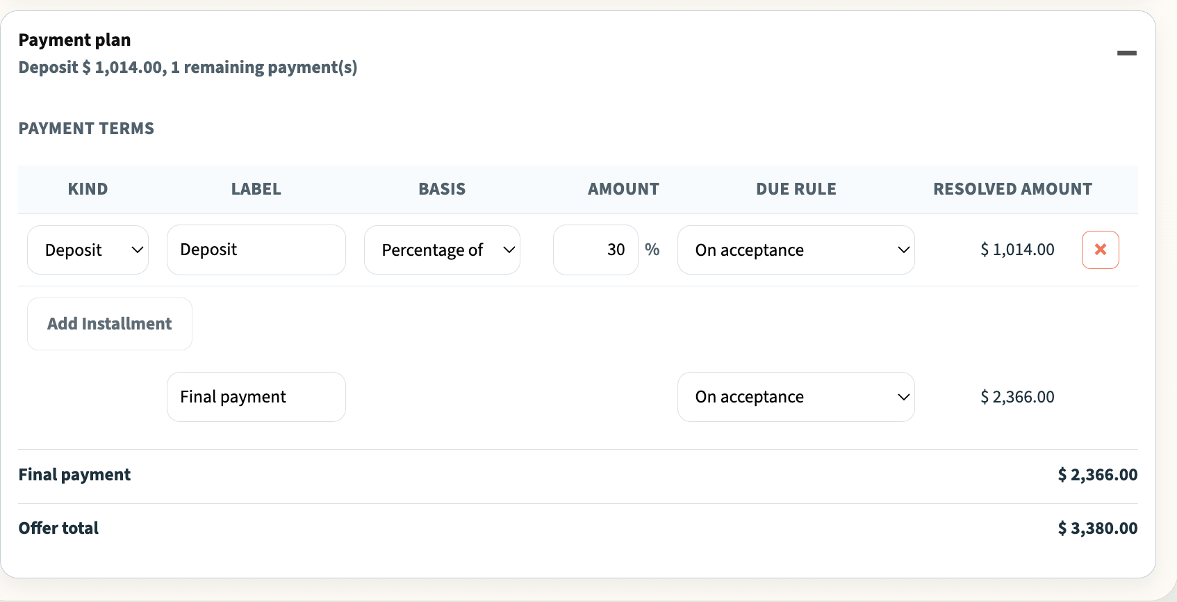
Add Deposit
Add Installment

Slide 9


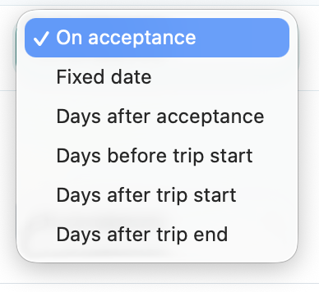
Deposit
$ 480
Add Installment

